Slide 1
DOLLY AND POLLY
CLONING
PARTICIPATING STUDENTS – *RATNADEEP CHATTERJEE*, DEBANGANA SAHA, TANOY KHAN.
BANGABASI MORNING COLLEGE.
DEPARTMENT OF ZOOLOGY.

Slide 2
INTRODUCTION
The process of producing genetically identical individuals of an organism either naturally or artificially is called cloning.
There are several techniques for cloning such as Gene cloning, Reproductive cloning, and Therapeutic cloning.
Gene cloning involves copying a specific gene and inserting it into a host organism.
Reproductive cloning involves creating a genetically identical copy of an entire organism by transferring its genetic material into an egg cell.
Therapeutic cloning involves creating Embryonic Stem cells for medical research and treatment purposes.
Coined by Herbert J. Webber, the term Clone derives from the ancient Greek word klon , which is the process whereby a new plant is created from a twig.

Slide 3
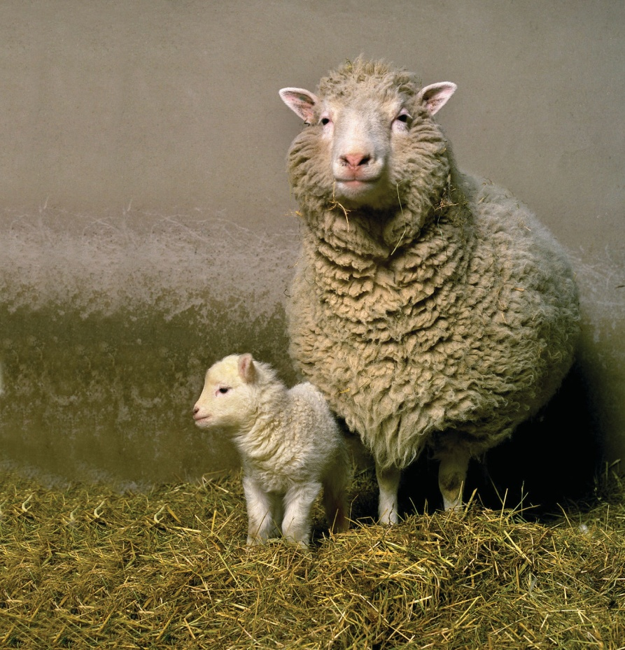
A look back at how a Scottish sheep changed the world of science. It was the 5th of July, 1996 that Dolly, the sheep was born, the ultimate product of a series of cloning experiments that would soon rock the research world. Her birth, reported the following year in Nature , made Dolly and the scientists who created her instant celebrities.
Hi! It’s Dolly..

Slide 4
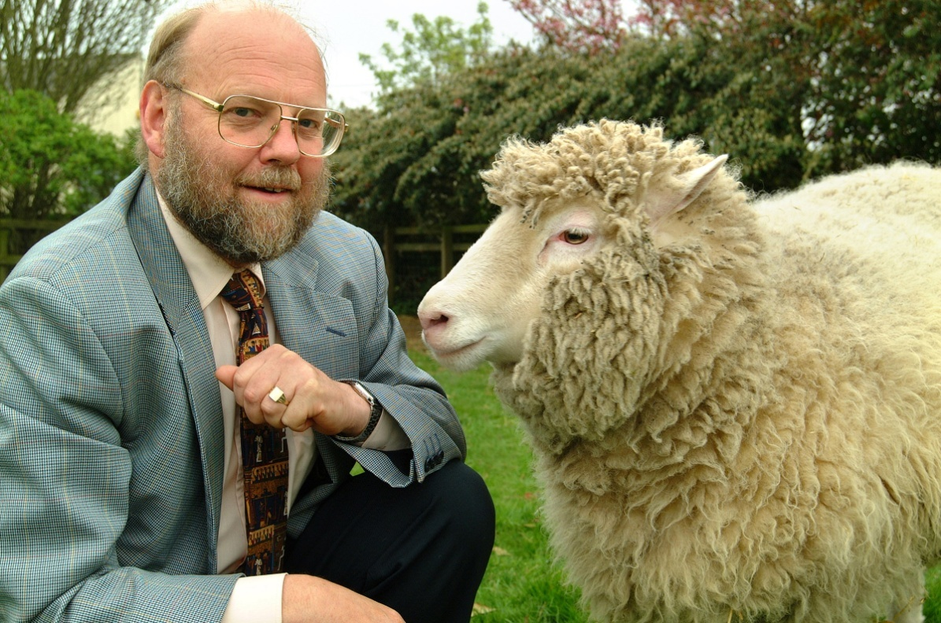
Dolly was the first mammal successfully cloned
from an adult somatic cell rather than an embryonic
cell.
British development biologist, Sir Ian Wilmut and
his colleagues of the Roslin Institute, near
Edinburgh, Scotland was responsible for this cloning.
They had concentrated on developing the technology using sheep “because sheep in Scotland are very, very, very cheap.”

Slide 5
The marvellous Process that gave birth to dolly….
Enucleating the eggs produced by Scottish Blackface Ewes (female sheep) :-
The ewes were treated with Gonadotropin- Releasing Hormone (GnRH) to cause them to produce oocytes ready to be fertilized.
A micropipette is then plunged into the egg over the polar body and the polar body along with the haploid pronucleus is sucked out from within the egg.

Slide 6
II. Each enucleated egg is fused with a diploid cell growing in culture :-
Cells from the mammary gland of an adult Finn Dorset ewe (they have white faces) were grown in tissue culture.
Five days before use, the nutrient level in the culture was reduced so that the cells stop dividing and enter into G⁰ of the cell cycle.
Donor cells and enucleated recipient cells were placed together in culture.
The cultures were exposed to pulses of electricity to -
Cause their respective plasma membranes to fuse;
Stimulate the resulting cell to begin mitosis (by mimicking the stimulus of fertilization).

Slide 7
III. The cells were then cultured until they have grown into a morula (solid mass of cells) or even into a blastocyst (6 days).
IV. Several of these were transferred into the uterus of each (of 13, in this case) Scottish Blackface ewes (previously treated with GnRH to prepare them for implantation).
V. Now, with their fingers crossed, the scientists waited for the result.
RESULT :- One ewe gave birth (148 days later) to Dolly.

Slide 8
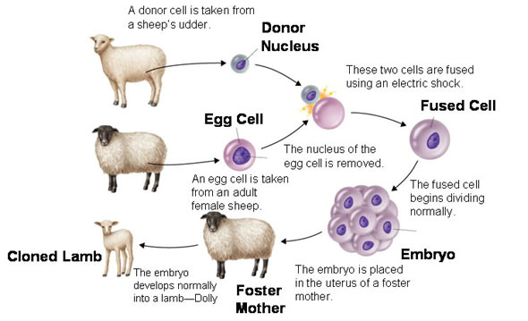

Slide 9
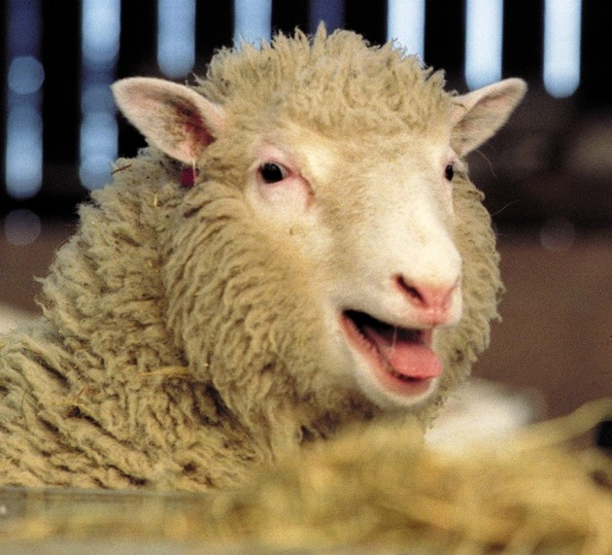
When Dolly was one year old, analysis of her DNA showed that her telomeres were shorter than would be expected for a normal sheep of the same age. Telomeres are ‘caps’ on the ends of DNA molecules that protect the DNA
from damage. As an animal or person ages, their
telomeres become progressively shorter, exposing the
DNA to more damage.
It’s thought that Dolly had shorter telomeres were
because her DNA came from an adult sheep and the
telomeres had not been fully renewed during her
development. This could have meant that Dolly was
‘older’ than her actual age.

Slide 10
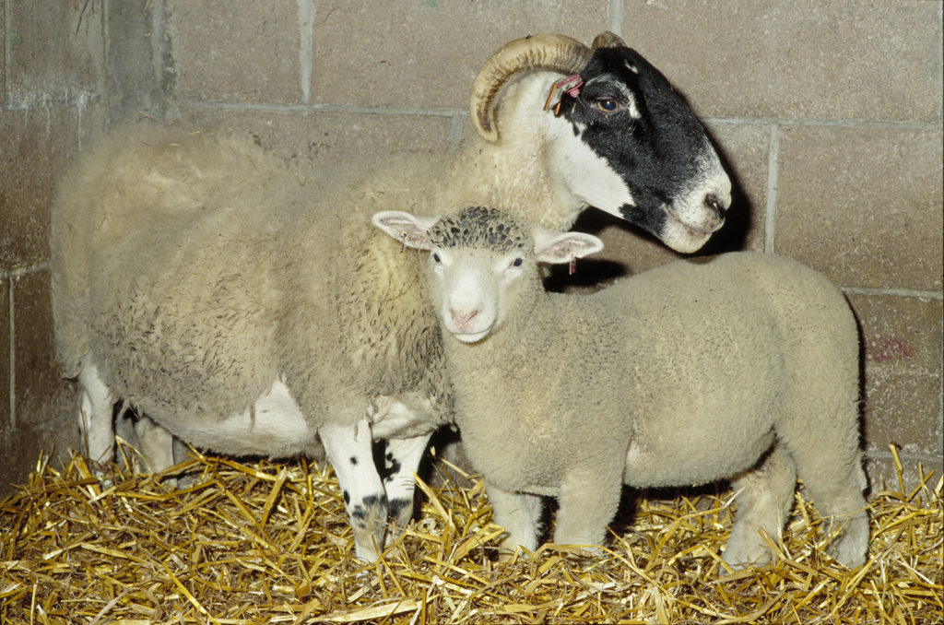
How do we know that Dolly is not the progeny of an unsuspected mating of the foster mother ? Did the scientists at Roslin institute fool us ?
Well, the answer to this question is NO. They didn’t fool us.
She had a white face but the foster mother was a
Scottish Blackface, which means they didn’t
resemble to each other.
DNA fingerprinting of Dolly reveals bands found in
Finn Dorset sheep (the breed that supplied the
mammalian cells), not those of Scottish Blackface
sheep.

Slide 11
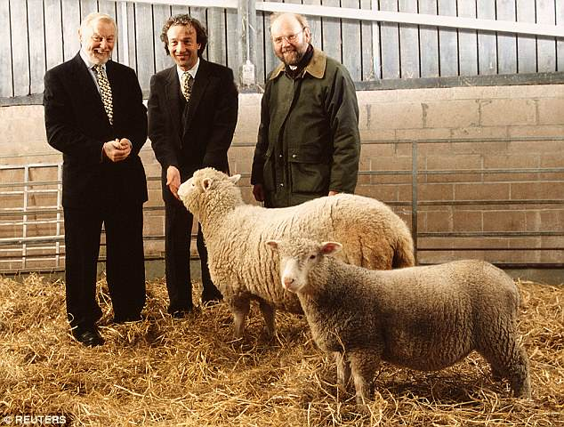
Look who’s born, it’s polly the sheep !
Less than a year after the creation of Dolly, Wilmut and his team created the transgenic lamb Polly, combining animal and human genetic material and utilizing the embryo
splitting technique.
Polly was born in 1997.
Polly was a Poll Dorset clone made from nuclear transfer using a
fetal fibroblast nucleus genetically engineered to express a human
gene known as FIX .
This gene encodes a substance called Human Factor IX, a clotting
factor that occurs naturally in most people but that is absent in
people with Hemophilia, who require replacement therapy with a therapeutic form of the substance.

Slide 12
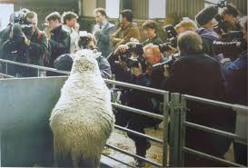
What’s the difference? Just “d” and “p”?
There are substantial differences between the two experiments:
a) Dolly has the same nuclear DNA as the donor ewe, while
Polly contains part of the DNA from the donor ewe and part
from human DNA;
b) Dolly was 'cloned' from specialized adult cells, while Polly
was created from embryonic stem cells. Polly is aimed at
producing a line capable of supplying milk containing
1-antitrypsin, a human plasma protein used in the treatment of
cystic fibrosis, thereby opening the way for the large-scale,
low-cost production of other human proteins.

Slide 13
Ethical issues
While their creation was a major scientific achievement, it also raised several ethical concerns, including :
Animal welfare – Dolly’s cloning was achieved after multiple failed attempts, which raises ethical concerns, regarding animal welfare. Animals used in scientific research should not be subjected to unnecessary pain or suffering.
Potential to Human Cloning – The successful cloning of Dolly raised fears that it could open the door to human cloning. The prospect of cloning humans raises a host of ethical, legal, and social concerns, such as questions about the safety of the cloning process and concerns about the commodification of human life.
Potential genetic abnormalities – Dolly’s creation raised concerns about the possibility of genetic abnormalities in cloned animals. In fact, Dolly died at the age of six due to a lung disease that is common in older sheep, but which typically does not affect sheep of her age.

Slide 14
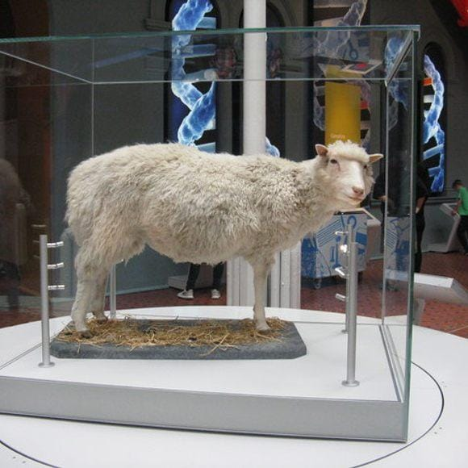
CONCLUSION
The birth of Dolly the sheep through somatic cell nuclear transfer (SCNT) was a significant milestone in the field of genetics and reproductive biology. It proved that adult cells could be reprogrammed to a state where they could produce a fully formed animal, and it opened up new possibilities for genetic research and animal breeding.
However, Dolly's birth also raised ethical questions about the safety and morality of
cloning. Concerns were raised about the potential health risks to cloned animals and
the possibility of cloning humans, which could lead to a host of ethical and social
issues.
Since Dolly's birth in 1996, significant progress has been made in the field of SCNT,
including the cloning of other mammals such as cats, dogs, and horses. However,
cloning remains a controversial and complex issue, and the long-term effects of
cloning on animal health and welfare are still being studied.
Where is Dolly now?
Ans. After her death, the Roslin Institute donated Dolly’s body to the National Museum of Scotland in Edinburgh, where she has become one of the museum’s most popular exhibits.

Slide 15
REFERENCE
CAMPBELL, K. H. S.; McWHIR, J.; RITCHIE, W. A. & WILMUT, I., 1996. Sheep cloned by nuclear transfer from cultured cell line. Nature, 380:64-66.
KLOTZKO, A. J. J. D., 1997. A report from America. The debate about Dolly. Bioethics, 11:427-438.
WILMUT, I., 1997. One small step for a sheep. New Scientist, 2071:4.
www.sciencedirect.com
https://www.researchgate.net
https://Britannica.com
https://dbpedia.org/page/Polly_and_Molly
https://www.irishtimes.com/news/cloned-polly-the-lamb-carries-human-genes-1.91523
https://www.jstor.org/stable/30301616
https://www.usnews.com/news/national-news/articles/2017-02-22/20-years-after-dolly-everything-you-want-to-know-about-the-cloned-sheep
U.S. National Bioethics Advisory Committee. 6 June 1997. "Cloning Human Beings." ,Washington, DC. Winston, R. 1997. "The Promise of Cloning for Human Medicine." British Medical Journal, 314:7085.

Slide 16
ACKNOWLEDGEMENT
We would like to take this opportunity to acknowledge everyone who has helped me in every stage of this presentation. We are deeply thankful and wish to express my sincere gratitude to our respected Principal Dr. Amitava Dutta Sir.
We are sincerely thankful and wish to express my gratitude towards our teacher Dr. Sreejata Biswas ma’am (Department of zoology) for her guidance to do this presentation on Dolly and Polly Cloning. Her useful advice and suggestions were really helpful to us during the presentation’s completion. In this aspect, we are grateful to her.
I’d like to express my gratitude to my friends and my partners for their constant support and help. Without them it would have been quite a tough challenge for me, but their presence made it quite easy and interesting.
Last but not the least, I would also like to acknowledge the endless contributions of my parents who always encourage me.

Slide 17
THANK YOU EVERYONE

